Slide 1




Slide 2

BUSINESS ETIQUETTE - GATHERING INFORMATION, ANALYSIS, DETERMINING

Slide 3

BUSINESS ETIQUETTE - GATHERING INFORMATION, ANALYSIS, DETERMINING
What is information?
Notes:
Information is facts provided or learned about something or someone.
"a vital piece of information"
Now let’s recap about Business Etiquette -
Business Etiquette is a set of social, professional and cultural sensibilities that a person is expected to possess in order to be considered a well-informed business-person with proper business acumen. Business Etiquette focuses primarily on being polite in your interactions with people and paying them respect while dealing with them, the way you would expect them to.
This politeness and respect is not limited to meetings held in person only. In fact, these levels of mutual respect and the polite way of addressing people and dealing with them is extended to business emails, telephonic conversations and business letters too.

Slide 4

Have you heard of the word ‘Netiquette’
Notes:
Netiquette is the correct way of conducting yourself while communicating online. The word netiquette was derived by combining “net” and “etiquette.”
While social etiquette has evolved over time and differs based on culture, digital etiquette is fairly new. As more people spend time online and technology advances, it’s important to be aware of how we are interacting online. Following netiquette guidelines can help you maintain a positive online presence.

Slide 5

Few rules of Netiquette

Slide 6

Conversation with real people
Notes:
What frequently gets people into trouble when communicating online is that they easily forget they are communicating with real people. There’s a human behind the words you’re reading. It’s easier to shoot back a response to a negative comment because you’re looking at text on a screen rather than looking at someone in the eyes. There’s a certain anonymous freedom, although nothing is really anonymous on the Internet.
It’s also easy to misread the context of someone’s words when you can’t see their facial expressions or body language. How often have you read something that you thought meant one thing, when it really meant something quite different? Meaning can also get lost in translation when auto-correct changes your text or sloppy typing leaves out key words.

Slide 7

Adhere to the same standards of behavior online that you follow in real life
Notes:
There’s something freeing about being potentially anonymous, or at least faceless, that ignites a feeling of freedom to say things that you would never say in person. You can type it, and then shut down your computer or log out of Facebook. You can ignore everyone’s response, at least for a little while.
But this kind of cyber behavior can still get you into trouble — it just may not be as immediate as if you were listening to their response in person. For instance, copying someone else’s work can violate copyright laws. In addition, saying someone did something when they didn’t could harm their reputation and be considered libelous. On a more personal level, you could risk alienating yourself from a group of friends, family members, or colleagues because of something you’ve written.

Slide 8

Respect others’ time and bandwidth
Notes:
The information overload in today’s society can be overwhelming. It’s important to respect people’s time, keeping your online communication succinct and to the point.
It’s also wise to keep in mind that your communications, whether they’re in the form of emails or online posts, take up space in storage systems. Bombarding mailing lists with large files or unnecessary data is not looked upon favorably.

Slide 9

Make yourself look good online
Notes:
Spelling and grammar are meaningful in online communication. Content also is key. Before you post about “knowing” something, be sure you actually know what you’re talking about.
Another potential drawback of online communication? It’s too easy to type out a negative comment if someone ruffles your feathers. Sometimes letting something sit for a day — or at least a few hours — can be helpful in deciding if you really need to post that comment. Often, you’ll feel relieved you didn’t react, or over-react, too quickly.
Chat rooms can be particularly tempting. Swearing, starting flame wars, or posting comments that you know will cause controversy, is just poor netiquette. It’s also important to keep in mind that writing a message in all caps is considered poor online etiquette, because it is commonly understood to be the equivalent of shouting at the recipient.

Slide 10

Share expert knowledge
Notes:
One of the true benefits of expanded online communication is the ability to share and retrieve expert knowledge quickly. If you’re an expert and have research or news to share, this is one of the best uses of the internet.

Slide 11
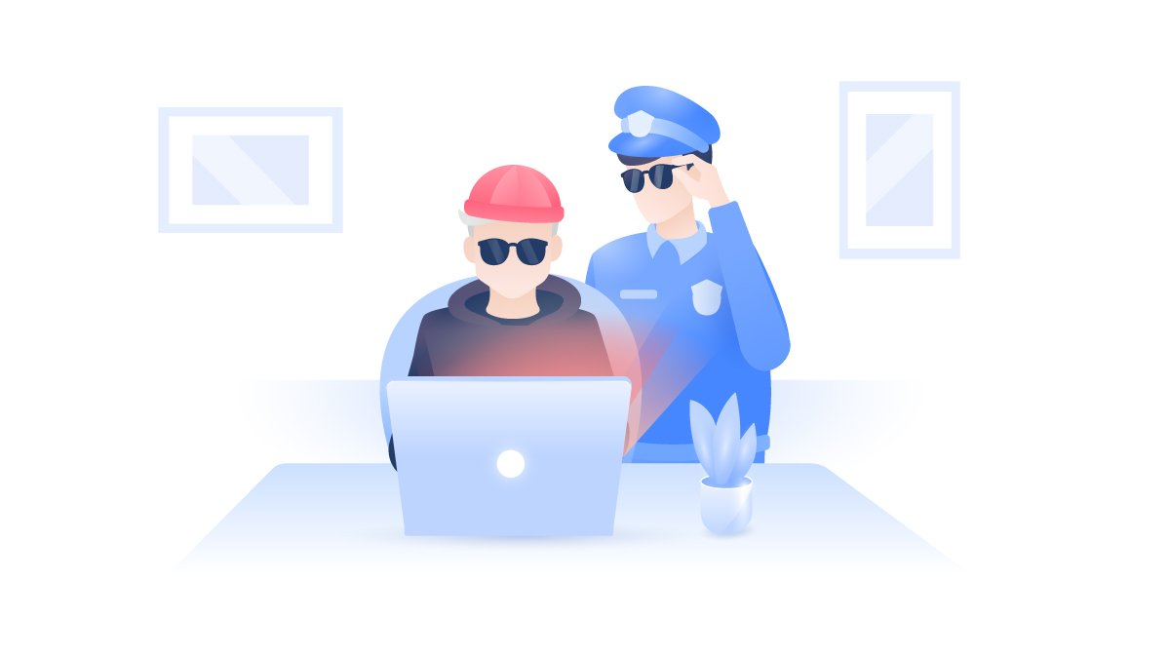
Respect one another's privacy
Notes:
This ability to share information at the touch of a button comes with responsibility. An important netiquette rule is respecting the privacy of others. You should not publicly identify or post private information about someone especially as a form of punishment or revenge, a practice known as doxxing.
You should also avoid snooping around in someone’s else’s computer or email to find out information that normally wouldn’t be open to you. With everything written down, it can be tempting for others to try to gain access to our private information.

Slide 12

Consequence of poor etiquette
Notes:
The ability to reach out to real people with one quick click of a button can be wonderful. You’re given access to new worlds of information. But this ease of communication — and ability to speak behind the cloak of your devices without face-to-face contact — brings up several issues that can present real challenges.

Slide 13
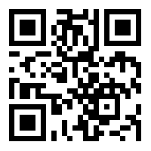
https://learn.codemithra.com

Slide 14




THANK YOU
+91 78150 95095
codemithra@ethnus.com
www.codemithra.com

